Slide 1


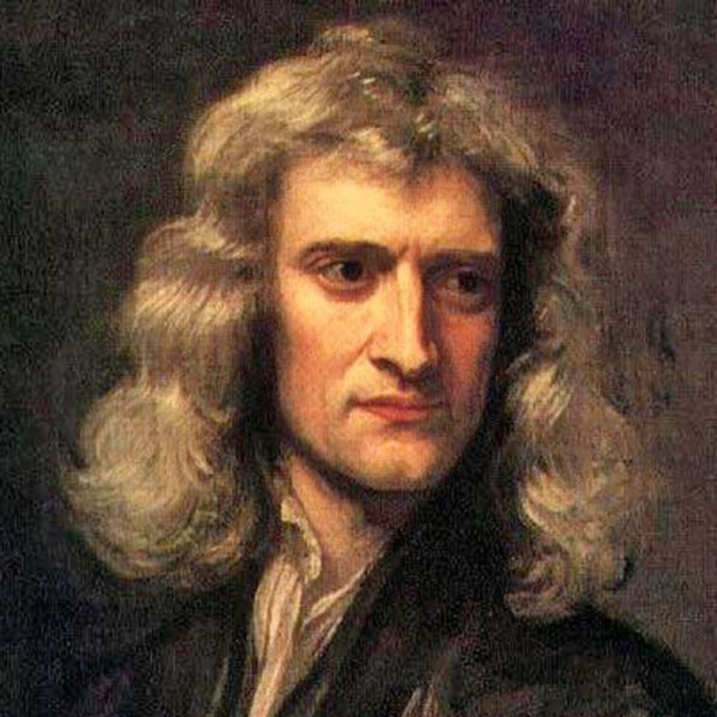
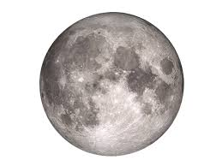
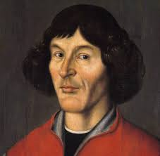

解密神奇的宇宙 Unlocking the secrets of the Universe
Session 4.1: from the Big Bang to colonizing the Universe
Where do we come from?
Today’s VIP guest list
According to the Big Bang theory, in the beginning, there “was nothing”: not even time, so we can’t even reasonably talk about what “happened before” this point. The Big Bang only took nanoseconds to happen, and billions of years later, as result of a series of accidents, here we are: the intelligent human race likely to soon start colonizing another planet.
When the Big Bang happened, almost all of “stuff”: matter and anti-matter was completely destroyed in a huge explosion. This is what happens whenever matter meets anti-matter.
But for some reason, in early Universe there must have been a little more matter than antimatter – and this tiny amount made up the whole Universe we know and observe today. Dark Energy could be the key to solving this mystery.
Dark Energy also keeps the Universe expanding at an ever-increasing speed. It is possible it will keep expanding “forever”, at some point faster than the speed of light, turning reality into a gigantic “black hole”
Isaac Newton
Session objectives
Introduce basic knowledge of the Big Bang, and the mysterious matter-anti matter asymmetry of the universe
Understand how we can prove the Big Bang theory
Discuss the expanding Universe theory
Ponder evidence for the expanding universe theory and consider the future of the Universe
Key terms
Big Bang
大爆炸
Dark Energy
暗能量
Background Radiation
背景辐射
Black Body radiation
黑体辐射
Redshift
红移
Dark Matter
暗物质
JinJin STEM Academy

Slide 2
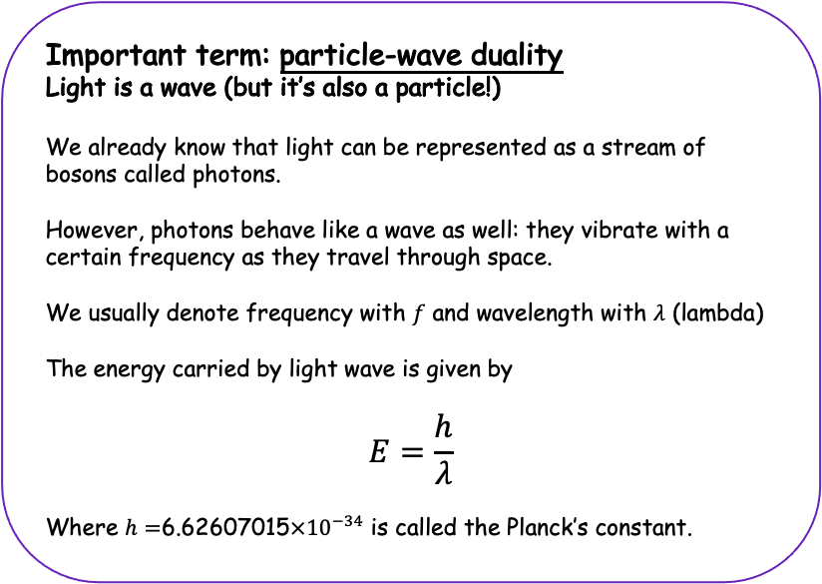
解密神奇的宇宙 Unlocking the Secrets of the Universe
Dark energy
暗能量
Mysterious force that makes the Universe expand!
We don’t know what it is, but we also cannot explain the Universe’s expansion using any known theory
Dark matter
暗物质
Mysterious matter that we cannot “see” or detect because it does not interact with any light. It does have mass, and we know that there is actually more dark matter in the universe than there is “normal” matter (that we are made of). However, we have no idea what dark matter is.
Big Bang
大爆炸
The big explosion at the beginning of everything we understand. According to the big bang theory, the Universe (including the spacetime itself) was created in this huge explosion around 13.8bn (138亿) years ago
Where is the missing anti-matter?...
At Big Bang, matter and anti-matter where at almost perfect balance. The fact that there was a tiny, tiny little bit more matter is the reason the Universe as we know it today exists. Everything else exploded (since matter+anti-matter = boom! + photons).
Why there was this asymmetry at the dawn of time is one of the big mysteries of the universe that we don’t have an answer to. One of the possible answers would be that antimatter and matter were separated too quickly to annihilate one another, due to the dark energy pull.
The Universe is glowing!
One of the earliest discoveries confirming the Big Bang theory was the discovery of Cosmic Background Radiation. If we use an appropriate apparatus, we can see that the space between stars in the sky at night is not actually black at all, but “glowing” very faintly in the microwave spectrum of light.
What does this “glowing” come from?
The glowing is uniform across the sky: it comes from everywhere. We believe it comes from the Big Bang: in the past, the universe was very dense and very hot. As the Universe cooled down over millions of years, the intensity of this light has also steadily decreased – this is why we are not boiled by the energy coming from the Big Bang anymore!
Important term: particle-wave duality
Light is a wave (but it’s also a particle!)
We already know that light can be represented as a stream of bosons called photons.
However, photons behave like a wave as well: they vibrate with a certain frequency as they travel through space.
We usually denote frequency with $f$ and wavelength with $λ$ (lambda)
The energy carried by light wave is given by
$$E=\frac{h}{λ}$$
Where $h=$6.62607015$×{10}^{−34}$ is called the Planck’s constant.
JinJin STEM Academy

Slide 3
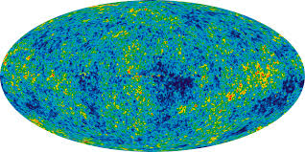
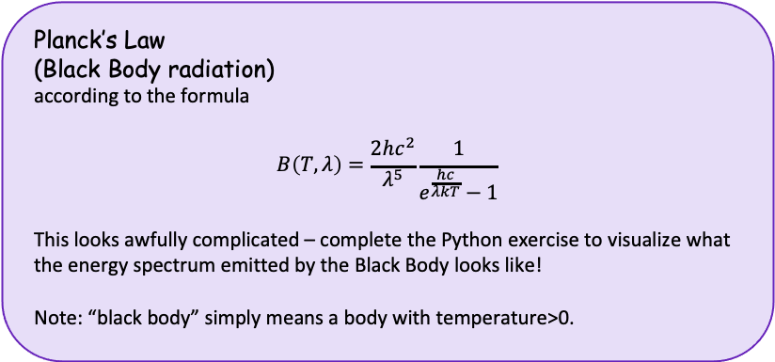
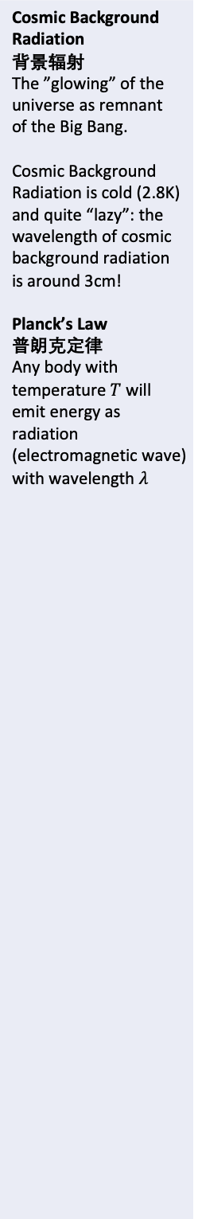
解密神奇的宇宙 Unlocking the Secrets of the Universe
Cosmic Background Radiation
背景辐射
The ”glowing” of the universe as remnant of the Big Bang.
Cosmic Background Radiation is cold (2.8K) and quite “lazy”: the wavelength of cosmic background radiation is around 3cm!
Planck’s Law
普朗克定律
Any body with temperature $T$ will emit energy as radiation (electromagnetic wave) with wavelength $λ$
The Cosmic Background Radiation landscape
Because we can measure the electromagnetic waves coming to Earth from all corners of the Universe, we can visualize how “hot” the background radiation is. On average, the universe is just ~2.8K (0K is the absolute zero – you cannot get colder than that!
Consider the cosmic background radiation “map” presented below. The yellow / red regions are slightly “hotter” (they carry more energy) than the green / blue regions.
Why would the cosmic background radiation not be perfectly uniform across the universe?
What do the “hotter” regions represent?
Planck’s Law
(Black Body radiation)
according to the formula
$$B\left(T,λ\right)=\frac{2hc^{2}}{λ^{5}}\frac{1}{e^{\frac{hc}{λkT}}−1}$$
This looks awfully complicated – complete the Python exercise to visualize what the energy spectrum emitted by the Black Body looks like!
Note: “black body” simply means a body with temperature>0.
JinJin STEM Academy

Slide 4
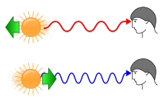
解密神奇的宇宙 Unlocking the Secrets of the Universe
Cosmic Background Radiation
背景辐射
The ”glowing” of the universe as remnant of the Big Bang.
Cosmic Background Radiation is cold (2.8K) and quite “lazy”: the wavelength of cosmic background radiation is around 3cm!
Planck’s Law
普朗克定律
Any body with temperature $T$ will emit energy as radiation (electromagnetic wave) with wavelength $λ$
The Universe is expanding!
The Universe is expanding at an increasing speed. The only explanation we have for the phenomenon at the moment is the effect of the Dark Energy, a mysterious force that we don’t know much about.
What will happen if the Universe accelerates “forever”?
What will happen if galaxies start moving away from one another faster than light?
Redshift 红移
We can observe effects of the Universe’s expansion to prove the expansion theory. When a galaxy is accelerating away from Earth, the light coming from this galaxy towards Earth will need to cover the same distance in shorter time (as speed of light is constant), so its wavelength will get extended. A longer wavelength means shift towards the “red end of the spectrum”: red light has longer wavelength than blue light. Hence, this phenomenon is called the “redshift”
The opposite of redshift is the blueshift, when wavelength of light gets compressed due to the light source (the galaxy) accelerating away from Earth.
JinJin STEM Academy

Slide 5
解密神奇的宇宙 Unlocking the Secrets of the Universe
Session Summary
The Universe was formed in the Big Bang, a huge explosion at the beginning of time. Almost all of matter and anti-matter was destroyed in the Big Bang, but for some reason – likely due to dark energy’s pull – some of the matter survived the explosion and formed the Universe
One of the key pieces of evidence confirming Big Bang theory is the Cosmic Background Radiation, the remnant of the Big Bang.
We can prove the Universe’s accelerating expansion by observing the Redshift of the light coming to Earth from distant galaxies
Ponder before next class
How do we know that the Universe is likely not going to “stop expanding” due to gravitational pull of all the matter in it?
If the universe keeps cooling down, will it completely “freeze” at some point with the temperature of vacuum falling down to 0K? What will this mean for the universe and for life in the universe?
Is it possible that certain regions of the Universe are expanding, while other regions are actually compressing? What observation or experiment could test this idea?
1
JinJin STEM Academy

